Slide 1

Hackathon 2018
Food supply power
Shift in the food power supply to change millions of lives

Slide 2
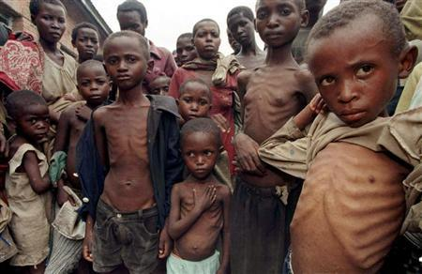
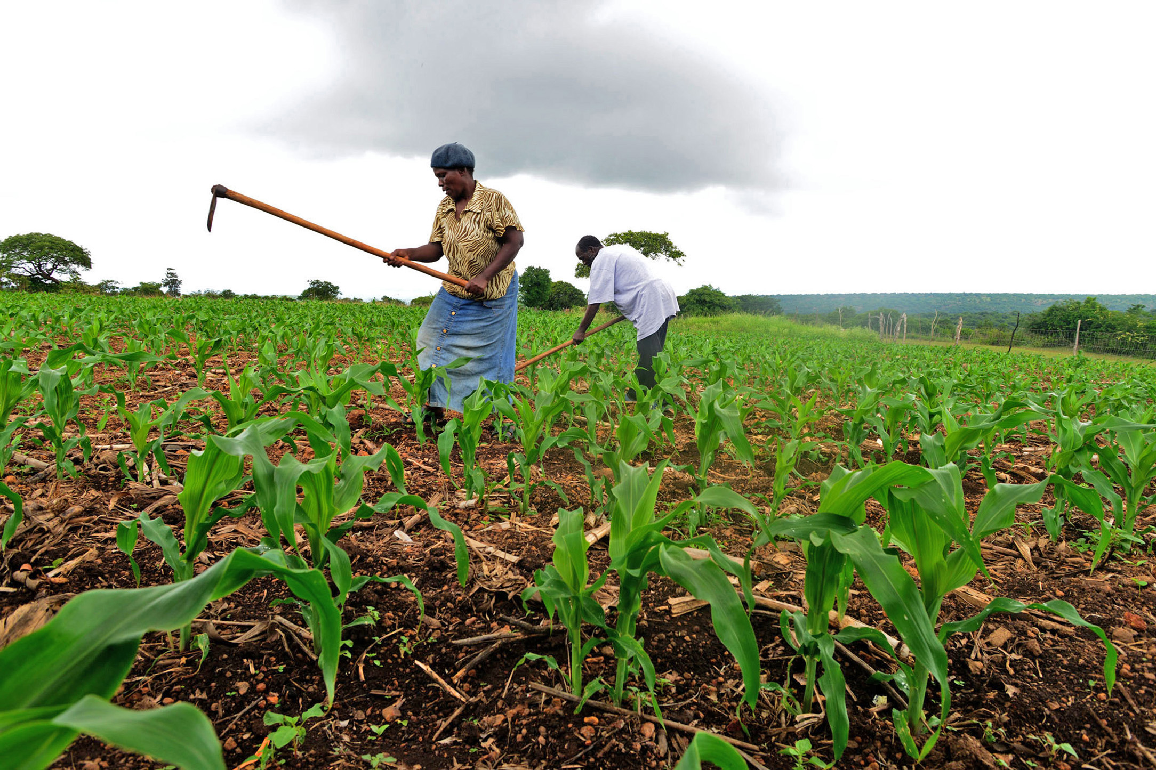
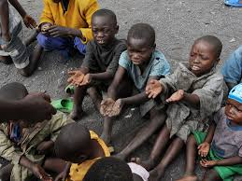
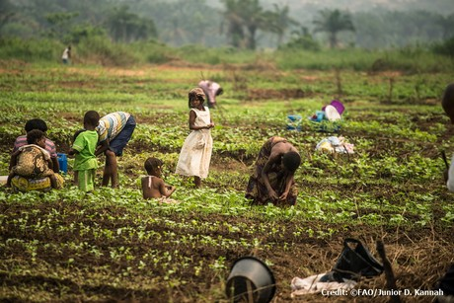
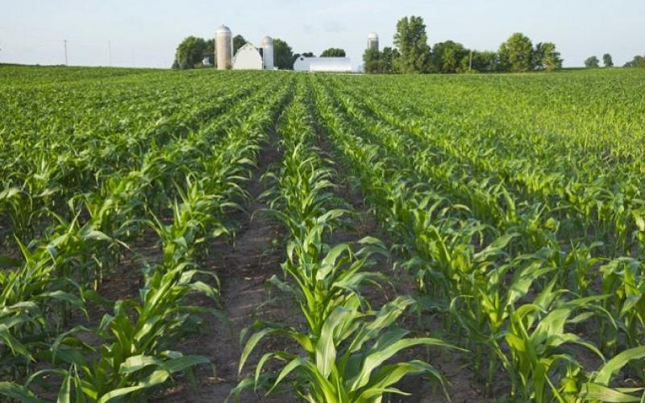
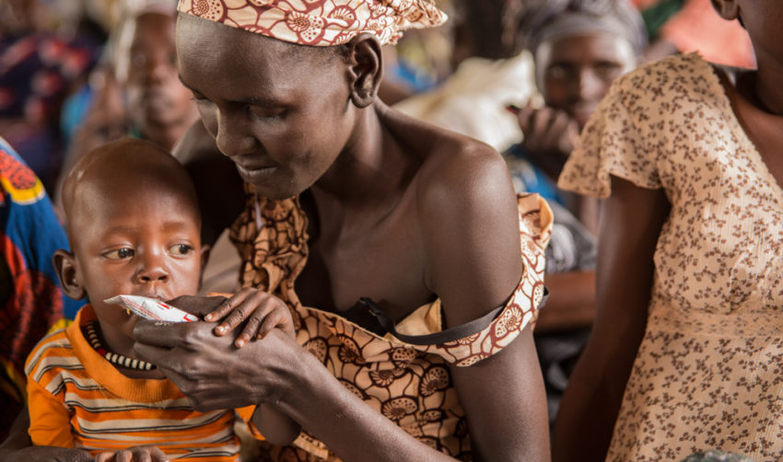
Hunger
Poverty
Devastation
<number>

Slide 3
Hunger and female power
501 million people in sub-Saharan Africa lived on that amount or less in a day
Of farmers in Africa are women workers
$1.90
40%
17%
If women were given the same access to productive resources as men
<number>

Slide 4

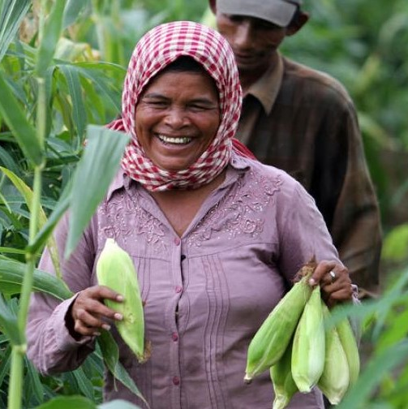


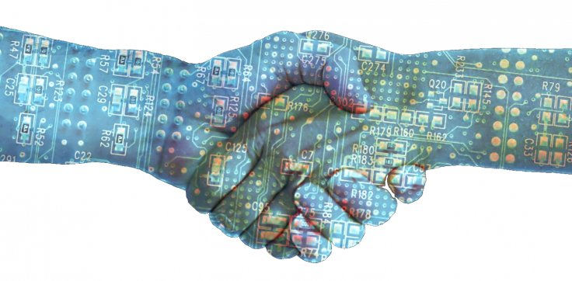
How we can change the situation?
Security
Opportunity
Transparency
Social impact
Power distribution
Protection of funds in case of political instability
A chance for female population to become entrepreneurs
Transparent relationships between retailers, farmers and land owners
A part of produced agricultural products goes into local community.
Developing of unused land for farming purposes
Taking some power away from the land owners and giving it to farmers. Changing of entire power dynamics
<number>

Slide 5


The current food supply model
Selling coffee beans
Buying coffee beans
<number>

Slide 6


Time for the radical change
Lease of land for farmer,
50% now, 50% after sale
Selling coffee beans
5% stays for farmer
UN is issuing tokens
Buying coffee beans
Farmland usage
Farmland usage
Farmland usage
Knowledge, equipment
<number>

Slide 7
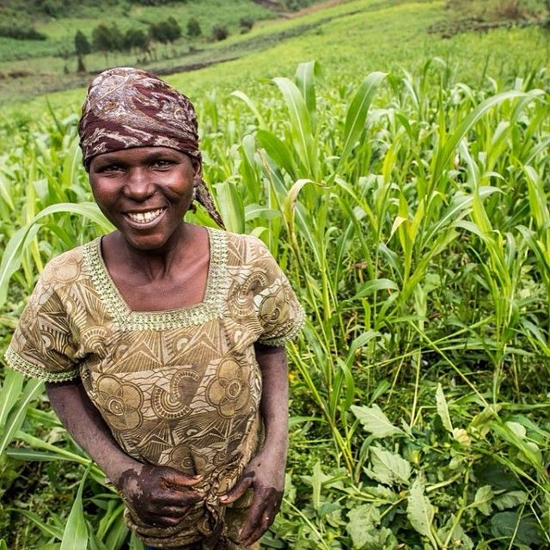
QI digital currency backed by UN
UN enforced new policies for the retailers to use QI for suppliers payments
Blockchain platform to connect Retailers, Independent Farmers and Land owners
Changing of power dynamics by giving opportunity to female farmers sell produces to retailers directly
Solution
Just technology will not solve a hunger problem but working together we can change it!
<number>

Slide 8

Digital Product
Emphasize your main benefit
Other benefits include
Nunc viverra imperdiet enim. Fusce est. Vivamus a tellus
Nunc viverra imperdiet enim. Fusce est. Vivamus a tellus
<number>

